Slide 1
DISTRIBUTED SYSTEM
UNIT 1
CHAPTER 4

Slide 2
THEORETICAL FOUNDATION
Inherent limitations of DS
1. No global clock
– Due to unpredictable message delay, it is
difficult to synchronize physical clocks
– Distributed schedule is difficult to implement
Impact of absence of global time: difficult to design
algorithms for distributed system.
2. No shared memory
– It is difficult to obtain a coherent global view,
which includes local state and messages
in transmission.
- An up to date state of the entire system is not available to individual process.

Slide 3
Physical Clocks
Clock skew
– The difference between two computers clocks
Clock drift
– Computers count time at different rates. The
underlying oscillators are subject to physical
variations such as temperature
– For ordinary clocks based on quartz crystal, the drift
is 10-7 seconds/second.
Coordinated Universal Time (UTC)
– Atomic oscillator: drift rate is about one part in 1013
– Broadcasted by radio or satellite and accessed
through global positioning systems (GPS)
– Accuracy in the order of 0.1 ms

Slide 4
Lamport’s logical clock
Lamport’s proposed this scheme to order the events in a distributed system using logical clock and execution of process characterized by a sequence of events.
Due to the absence of perfectly synchronized clock and global time in distributed system the order of two events occur at two different computers can not determined based on the local time at which they occur.
However under certain conditions it is possible to ascertain the order in which two events occur based solely on the behavior exhibited by the underlying computation.
Happened before relation: capture causal dependencies between events
A happened before relation → is defined as follows:
a → b, if a and b are events in the same process
and a occurred before b
a → b, if a is the event of sending a message m in a
process and b is the event of receipt of the same
message by another process
If a → b and b → c, a → c, transitive

Slide 5
Causal affects
In D.S. process interact with each other and affect the outcome of events of process.
Being able to ascertain order between events is very important for designing debugging and understanding the sequence of execution in distributed computation.
In general, an event changes the system state which in turn influence the occurrence and outcome of future events.
That is past events influence future events and this influence among causally related events is referred to as causal affects.

Slide 6
Causally & Concurrent Events
Causally related events:
- Event a causally affects event b if a → b.
Concurrent Events: does not causally affect each other.
- Note that a → a does not hold
- If a happened before b, it is possible that a causally
affects b.
- If neither a → b nor b → a, then we say a and b are
concurrent and write as a || b
- Happened before is a partial order
- Note that concurrency is not transitive
a || b and b || c does not imply a || c
- For any two events in the system, either
a → b or b → a or a || b

Slide 7
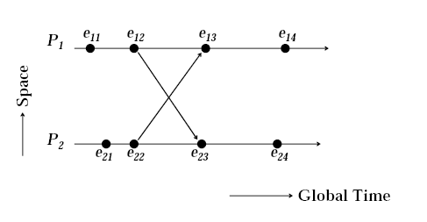
Space-Time Diagram

Slide 8
Lamport’s Logical Clocks
Goal: implement the happens before relation in a distributed system without global clock
There is a clock Ci at each process Pi in the system.
Clock Ci can be thought of as a function that assigned a number Ci(a) to any event a, called timestamp of a, at process Pi.
Number assigned by system of clocks have no relation to physical time.
• Assume each process has a clock (counter)
• A system of clocks is correct if a → b implies
C(a) < C(b)
• Happens before can be realized if the following two conditions are met:
[C1] For any two events a and b in a process Pi, if a → b
then Ci(a) < Ci(b).
[C2] If a is the event of sending a message in process Pi, and b is
the event of receiving the same message at Pj,
then, Ci(a) < Cj(b).

Slide 9
Implement the Logical Clock
Following IR for the clock guarantee that the clocks satisfy the correctness [C1] and [C2].
[IR1] Clock Ci is incremented between any two successive events in process Pi,
Ci := Ci + d (d>0)
– It’s easy to see if a and b are two successive events in Pi and a → b, then Ci(b) = Ci(a) + d.
[IR2] If a is the event of sending a message m, with timestamp tm := Ci(a), by process Pi. On receiving m by process Pj, Cj is set to a value greater than or equal to its present value and greater than tm.
Cj := max(Cj , tm +d) (d>0)
– Note that the message receipt event at P
increments Cj as per rule IR1.

Slide 10
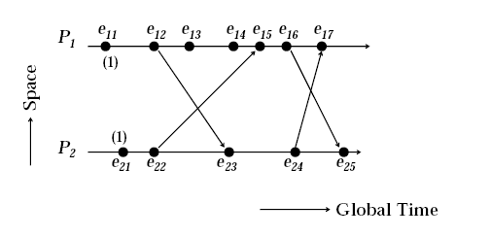
Lamport’s Logical Clock

Slide 11
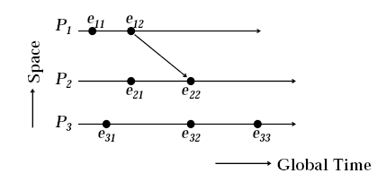
Limitations of Lamport’s Clocks
If a →b then C(a) < C(b). However the reverse is not necessary true if events occurred in different processes, but we know if C(a) < C(b) then what?
See figure, C(e11)< C(e22) and C(e11)< C(e32), however, e11 is causally related to event e22,but not to event e32, We can guarantee that if C(a)<C(b) then b!->a (future can not influence past)

Slide 12
Vector Clock
Vector clock is proposed to decide whether two events are causally related or not by simply looking at their timestamps.
Vector clock is an array of integers instead of just one integer. In a vector, each entry is used to represent the knowledge about the clock of other processes
Ci[j] denotes Pi’s knowledge about the logical time at Pj
Implementation Rules:
[IR1] Clock Ci is incremented between any two successive events in process Pi,
Ci := Ci(a) + d (d>0)
[IR2] If a is the event of sending a message m, with timestamp tm := Ci(a), by process Pi. On receiving m by process Pj, Cj is updated as follows:
∀k, Cj[k] := max(Cj[k], tm[k])
Assertion: At any time, ∀i, ∀j: Ci[i] ≥Cj[i]

Slide 13
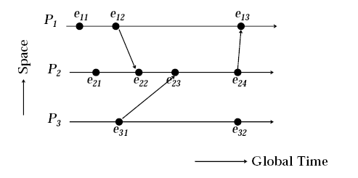
Vector Clock

Slide 14
Vector timestamps can be compared as follows: for ant two vector timestamps t^a and t^b of events a and b respectively:
Equal: t^a=t^b iff ∀i, t^a[i]=t^b[i];
Not Equal: t^a!=t^b iff Ei, t^a[i]!=t^b[i];
Less than or Equal: t^a<=t^b iff ∀I, t^a[i]<=t^b[i];
Not Less than or Equal to: t^a!<=t^b iff Ei, t^a[i]>t^b[i];
Less Than: t^a<t^b iff (t^a<=t^b AND t^a!=t^b);
Not Less than: t^a!<t^b iff -(t^a<=t^b AND t^a!=t^b);
Concurrent: t^a|| t^b iff (t^a!<t^b AND t^b!<t^a);
Note that the relation <= is a partial order. However, the relation || is not a partial order because it is not transitive.

Slide 15
Causal Ordering of Messages
Causal ordering: If send(m1) happens before send (m2),
then every recipient of both messages m1 and m2 must
receive m1 before m2.
Techniques for the causal ordering of messages are useful in developing distributed algorithm.
Applications: replicated database systems, the order may be important. E.g., account adjust
The Birman-Schiper-Stephenson protocol was implemented in ISIS. Where process are assuming to communicate using broadcast message.
Basic Idea: deliver a message to a process only if the message immediately preceding it has been delivered to the process. Otherwise, buffer it until the message immediately preceding it is delivered. A vector accompanying each message contains the necessary information for a process to decide whether there exists a message preceding it.

Slide 16
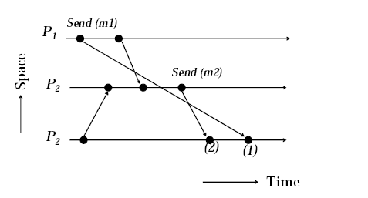
Violation of Causal Ordering of messages

Slide 17
Birman-Schiper-Stephenson protocol
1. Before broadcasting a msg m, a process Pi increments the vector time VTPi[i] and timestamps m.
– Note that (VTPi[i] –1) indicates how many messages from Pi preceded m.
2. A process Pj ≠ Pi, upon receiving message m timestamped VTm from Pi, delays its delivery until both the following conditions are satisfied.
a: VTPj [i] = VTm[i] –1 //ensures that process Pj has received all messages from Pi that precede m.
b: VTPj[k] ≥VTm[k] ∀k ∈{1,2,…,n} –{i} // ensure that Pj has received all those messages received by Pi before sending m.
Where n is the total number of processes. Delayed messages are queued at each process in a queue.
When a message is delivered at a process Pj, VTPj is updated according to the vector clock rule IR2

Slide 18
Global State
Recording a coherent global state in DS is challenging task in the absence of global clock and absence of shared memory.
The recorded global state may be inconsistent if
n< n’ or n > n’,
– where n is the number of messages sent by A along
the channel before A’s state was recorded.
– n’ is the number of messages sent by A along the
channel before the channel’s state was recorded.
Hence consistent global state requires n=n’
One can show that a consistent global state requires m=m’ where
- m is number of messages received along the channel before account B’s state was recorded
-m’ is the number of messages received along the channel by B before channel state was recorded.
So no system the number of messages sent along the channel can be less than the number of messages received along the channel. We have
n’>=m or n>=m // consistent global state satisfy this eqn.
Examples:
– Record state of A at state 1, and state of channel
and B at state 2, n = 0, n’ =1
– Channel at state 1, state of A and B at state 2, n’=0,
n=1.

Slide 19
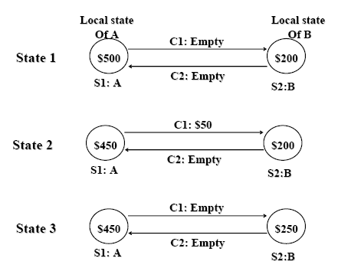
Example

Slide 20
Definitions: Local States
For a site Si its local state at a given time is defined by the local context of the distributed application. Let LSi denote the local state of Si at any time.
Let send(mij) denote the send event of a message mij by Si to Sj and rec(mij) denote the receive event of message mij by site Sj.
Time(x) denote the time at which state x was recorded and time(send(m)) denote the time at which event send(m) occurred.
For a message mij sent by Si to Sj, we say that
send(mij) ε LSi if and only if time(send(mij)) < time (LSi)
rec(mij) ε LSj if and only if time(rec(mij)) < time LSj.
Transit: transit(Lsi, LSj)={mij | send(mij) ε LSi Λ rec(mij) !ε LSj }
Inconsistent: inconsistent(LSi, LSj)= { mij | send(mij) ! ε LSi and rec(mij) ε Lsj}

Slide 21
Definition: Global States
a global state of a system is a collection of the local states of its sites, That is GS ={LS1, LS2, …LSn} where n is the number of sites in the system.
Note that any collection of local states of sites need not represent a consistent global states. Consistency has a connection that for every effect or outcome recorded in global state and the cause of the effect must also be recorded in the global states.
Consistent Global states: consistent iff
∀i, ∀j: 1 ≤i, j ≤n :: inconsistent (LSi, LSj,) = Φ
Transitless global states:
– a global state GS ={LS1, LS2, …LSn} is transitless iff, communication channels are empety
∀i, ∀j: 1 ≤i, j ≤n :: transit (LSi, LSj,) = Φ
Strongly consistent global states:
– It is consistent and transitless.

Slide 22
Chandy-Lamport Algorithm
Capture consistent global state. Algorithm uses a marker (message) to initiate algorithm. Assumptions: FIFO channel.
Marker sending rule for a process P
– P records its state
– For each outgoing channel C from P on which a
marker has not been already sent, P sends a marker along C before P sends further messages along C
Marker receiving Rule for a process Q. On receipt of a marker along a channel C:
If Q has not recorded its sate then {
Record the state of C as empty,
Follow the marker sending rule. }
Else {
record the sate of C as the sequence of
messages received along C after Q’s state
was recorded and before Q received the
marker along C }

Slide 23
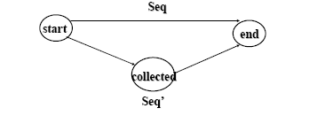
A Note on the Collected Global State
It’s possible that the collected global state is not identical to the real global state
– The state may change after the marker is sent out and before it is received
There exists a sequence of actions which can start from the initial state and reach the collected state by permutation.
Useful to detect stable properties, deadlock detection, and termination detection.

